Slide 1

Machine Learninge Giriş
Müdafer Kaymak

Slide 2

Makine öğrenmesi nedir

Slide 3
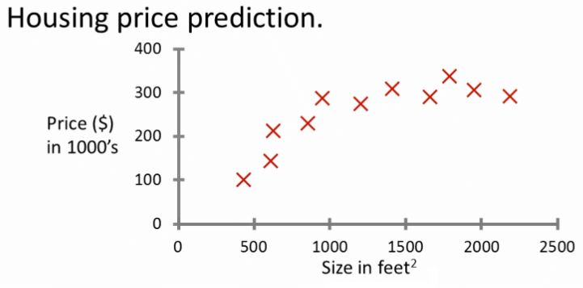
Lineer Regresyon

Slide 4

Classififaction

Slide 5
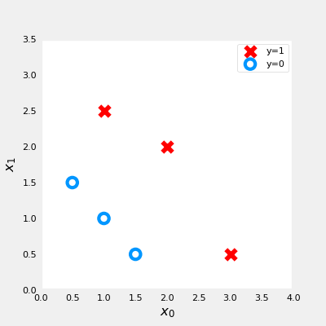
Logistic Regression

Slide 6
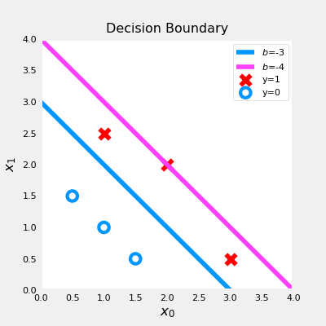

Slide 7
Cost Fonksiyonunun uygulanması
w_array1 = np.array([1,1])
b_1 = -3
w_array2 = np.array([1,1])
b_2 = -4
print("Cost for b = -3 : ", compute_cost_logistic(X_train, y_train, w_array1, b_1))
print("Cost for b = -4 : ", compute_cost_logistic(X_train, y_train, w_array2, b_2))
Output
Cost for b = -3 : 0.3668667864055175
Cost for b = -4 : 0.5036808636748461

Slide 8
